Slide 1

Spring Framework
SoftUni Team
Technical Trainers
Software University
https://about.softuni.bg

Slide 2
Table of Contents
Framework
Web Frameworks
Design Patterns
Spring Platform
Spring Data
Spring Boot
Spring Framework

Slide 3
Have a Question?
sli.do #Java-DB

Slide 4

Framework

Slide 5
Framework
Platform for developing software applications
Provides a foundation on which software developers can build programs for a specific platform
Similar to an API
A Framework includes an API
May include code libraries, a compiler, and other programs used in the software development process

Slide 6

Web Frameworks

Slide 7
Web Frameworks
Software framework
Designed to support the development of web applications
Web Services
Web Resources
Web APIs
Provide a standard way to build and deploy web applications

Slide 8
Server-side Web Frameworks
Software frameworks that make it easier to write, maintain and scale web applications
Provides tools and libraries that simplify common web development tasks
Example
Spring MVC
ASP.NET
Symfony

Slide 9
Client-side Web Frameworks
JavaScript library
Runs in a Web browser
Provides developers with tried and tested tools for building scalable, interactive web applications
Example
Angular
ReactJS
VueJS

Slide 10

Framework Design Patterns

Slide 11
Design Patterns
Model–View–Controller (MVC)
Divides an application into three major aspects: Model, View, and Controller
Model-View-Presenter (MVP)
It is derived from MVC pattern, wherein the controller is replaced by the presenter
Model-View-ViewModel (MVVM)
Two-way data binding between View and View-Model

Slide 12
Design Pattern: MVC
Users
View
Controller
Model

Slide 13
Design Pattern: MVP
Users
View
Presenter
Model

Slide 14
Design Pattern: MVVM
Users
View
View Model
Model

Slide 15

Spring Platform

Slide 16
Spring Plaform
Spring makes programming Java quicker, easier, and safer for everybody
Spring's focus is on speed, simplicity, and productivity built by multiple Spring Projects
Spring Boot
Spring Framework
Spring Data

Slide 17
Spring Module
Spring Core Container
The base module of Spring and provides Spring containers
Aspect-Oriented Programming
Enables implementing cross-cutting concerns
Authentication and Authorization

Slide 18
Spring Core:
– Context – place where the Beans live
- Bean – component managed by Spring through the Context
- when we need a Bean we do not create it, but inject it with DI through the Bean Interface
- Bean is Configuration + POJO

Slide 19
Spring Module (2)
Data Access
Working with RDBMS using JDBC and ORM tools
IoC Container
Configuration of application components and lifecycle management of Java objects, done mainly via dependency injection
Testing
Support classes for writing unit tests and integration tests

Slide 20
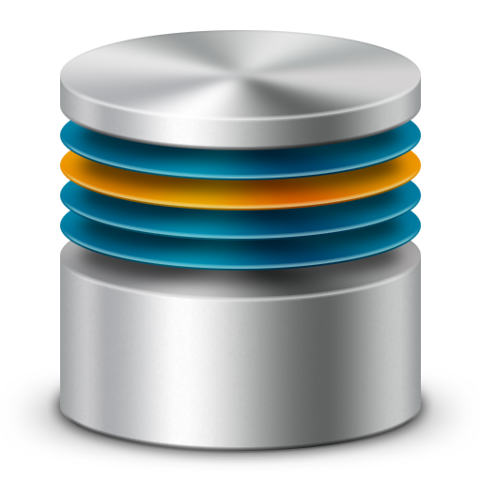

Spring Projects

Slide 21
Spring Projects
Spring Boot
Makes it easy to create stand-alone, production-grade Spring based Applications
Spring Framework
Provides a comprehensive programming and configuration model for modern Java-based enterprise applications - on any kind of deployment platform

Slide 22
Spring Projects (2)
Spring Data
Spring Data's mission is to provide a familiar and consistent, Spring-based programming model for data access while still retaining the special traits of the underlying data store
Spring Cloud
Spring Cloud provides tools for developers to quickly build some of the common patterns in distributed systems

Slide 23

Spring Boot

Slide 24



Spring Boot
Opinionated view of building production-ready Spring applications
Tomcat
pom.xml
Spring Boot
Auto configuration

Slide 25
Spring Framework

Slide 26
Spring Framework
Open Source Application framework and inversion of control container for the Java platform
Core features can be used by any Java application extensions for building web applications on top of the Java EE

Slide 27

Summary
…
…
…
A framework is an abstraction
Software framework that is designed to support the development of web applications
MVC
MVP
MVVM

Slide 28
Questions?
Notes:
28

Slide 29
Trainings @ Software University (SoftUni)
Software University – High-Quality Education, Profession and Job for Software Developers
softuni.bg, about.softuni.bg
Software University Foundation
softuni.foundation
Software University @ Facebook
facebook.com/SoftwareUniversity
Software University Forums
forum.softuni.bg
Notes:
29

Slide 30

License
This course (slides, examples, demos, exercises, homework, documents, videos and other assets) is copyrighted content
Unauthorized copy, reproduction or use is illegal
© SoftUni – https://about.softuni.bg/
© Software University – https://softuni.bg
Notes:
30

